Slide 1
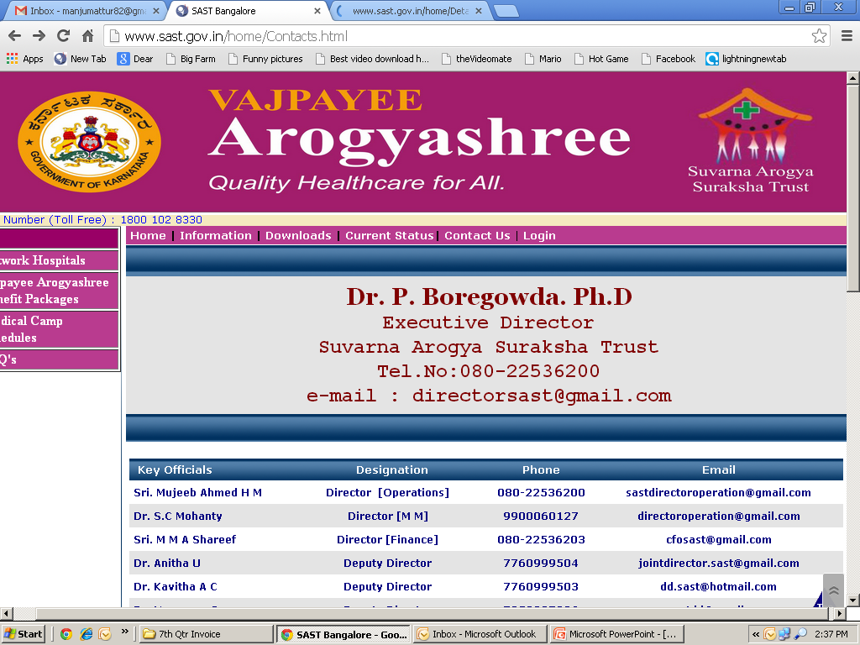
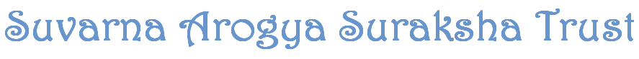
Government of Karnataka
Department of Health & Family Welfare
Health Insurance Schemes in Karnataka “Assessing & Promoting Equity”
KACHCON 2015
31st October 2015
Dr. P Boregowda¹, Dr. Sudhashre Chandrashekar², Suresh Wesley³, Praveen⁴

Slide 2
World Health Organization
“Equity is the absence of avoidable or remediable differences among groups of people, whether those groups are defined socially, economically, demographically, or geographically”
Reducing health inequities is important because health is a fundamental human right and its progressive realization will eliminate inequalities that result from differences in health status.

Slide 3
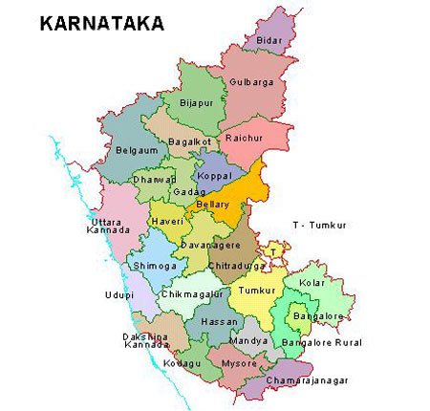
Profile of Karnataka
KARNATAKA – 2014
Population | 6.50 Crores
SC Population | 1.12 Crores (17.18%)
ST Population | 0.46 Crores (7%)
BPL Population | 4.46 Crores (68%)
Rural : Urban Ratio | 61:39
The districts of North Karnataka are most backward – Socially & Economically with poor infrastructure facility
Skewed development & distribution of population
Main livelihood of BPL families: Daily wage labourers (Seasonal)
About 40 % of the households live in One-Room tenement with no access to basic amenities

Slide 4
Promoting Equity to Economically Backward Community

Slide 5
Phase I: Addressing Economic Equity – Health Assurance to BPL Families
Strides towards promoting equity in Health Care
In 2009-10, Vajpayee Arogyashree (VAS), a health assurance scheme for BPL families -Tertiary Care comprising 7 specialties with 449 procedures
First implemented in backward divisions of Gulbarga & Belgaum in 2010 & entire State in 2012. (Phased approach to understand implementation issues)
Salient features:
An autonomously established Trust – “Suvarna Arogya Suraksha Trust”
Implementation Support Agency (ISA)
Arogyamitras
ASHA workers
Health Camps
IEC

Slide 6
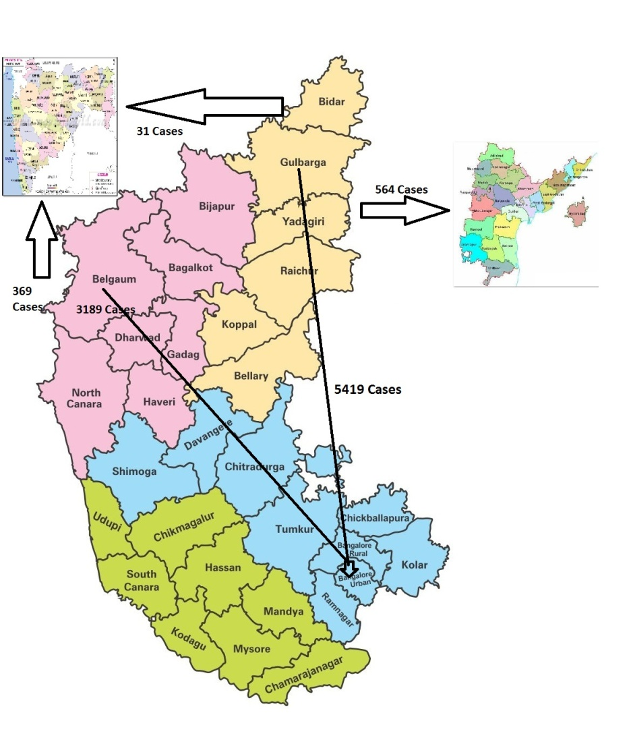
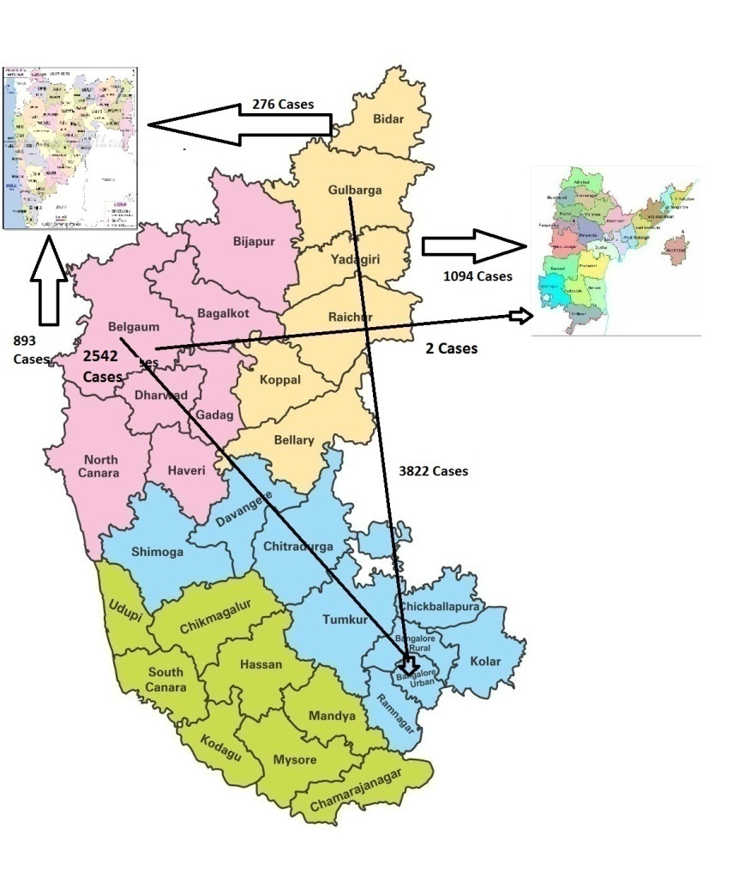
Phase II: Bridging Geographical Distance for Equity
Status 2013-14
Status 2014-15
Patients from North Karnataka had to travel all the way to Bangalore for treatment.
This created hardship & some patients expired on the way.
Border State Hospitals Empanelled.
2013-14 - No. of Cases
 | Gulbarga to | % | Belgaum to | %
Andhra Pradesh | 643 | 11.06 | 0 | 12.66
Maharastra | 31 |  | 569
Bangalore | 5419 |  | 3189
2014-15 - No. of Cases
 | Gulbarga to | % | Belgaum to | %
Andhra Pradesh | 1094 | 26.39 | 2 | 26.48
Maharastra | 276 |  | 1193
Bangalore | 3822 |  | 2524

Slide 7
Phase III: Targeting Most Vulnerable Groups for Equity – SC / ST & Hill Tribes
As of March 2014, the overall performance of the scheme since inception was assessed in terms of quantum of “Distributive Justice” achieved geographically and to most vulnerable groups among the deprived BPL section of society.
The above was indeed an eye opener – Utilization of VAS services was very low among SC & ST families.
It was also evident that Tribes living in hilly tracts had also missed out on availing the services under the scheme.
To ensure inclusive access to free qualitative health care, well planned Special Health Camps were organised exclusively targeting SC, ST and Tribal people with the active participation of elected representatives.

Slide 8
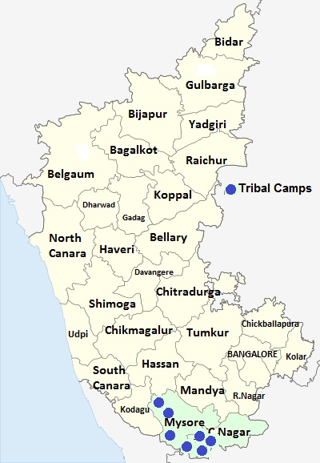
Special Health Camps held at Hilly Tribal Areas
Special Camps were held in 8 Tribal Areas in the Districts of Chamarajnaga, Mysore & Madikeri in the month of July 2014.
Tribal Camp Details & Outcome
District | No. of Camps | Regd. | Ref | Treated
Chamarajnagar | 4 | 997 | 86 | 9
Mysore | 3 | 1028 | 116 | 9
Kodagu | 1 | 145 | 13 | 4
Total | 8 | 2170 | 215 | 22

Slide 9
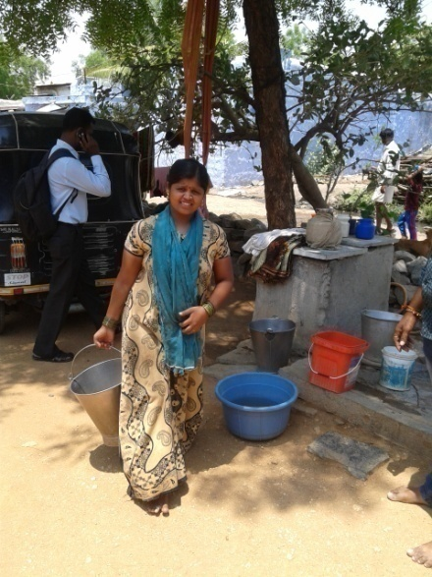
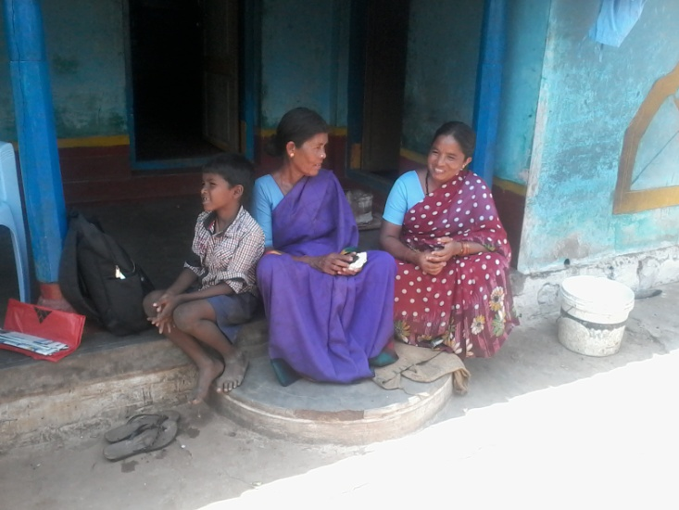
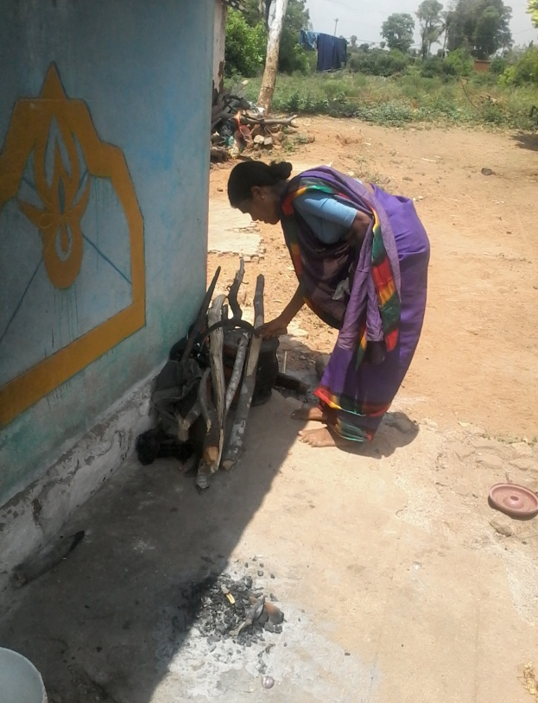
Case Study – Tribal Woman
Beneficiary | Mrs. Kunningamma W/o Maddaiah - Scheduled Tribe
Age | 55 years
Village | Chikkamalapura, Kollegala Tq, – 135 KM from Chamarajanagar District
Occupation | Hilly Dwellers – Gathering edible forest produce like honey, root tubers, herbs etc,.& marketed through middlemen
Current Status | Subsistence living
Problem & Identification | The family came to know about the Special Tribal Camp through the local Arogyamitra. As she was suffering fro extreme tiredness, attended Special health Camp organised in their tribal area on 20th July 2014. Was suspected to be suffering from Cardiac problem & was referred to Vikram Hospital, Mysore for detailed investigation and treatment. They agreed to go to Mysore for treatment only after they were assured that the treatment will be totally free.
Treatment | Underwent treatment for URSL – single side on 7th October 2014.
Beneficiary / Family reaction | After the treatment, the Chamarajanagar District Manager of ISA interacted with her to have her feedback. Her feedback is reproduced below in English: “ Living in hilly area, we are cut off from the main stream activities of the society. We were totally unaware of such health facilities. I have been lucky to receive this free medical treatment and was surprised with the nice way the hospital treated me. But for this facility, I think I would have been a dead person by now. Thinking back, I do not know how many of my elders from our community have died without the knowledge of such health facilities provided by the government”.

Slide 10
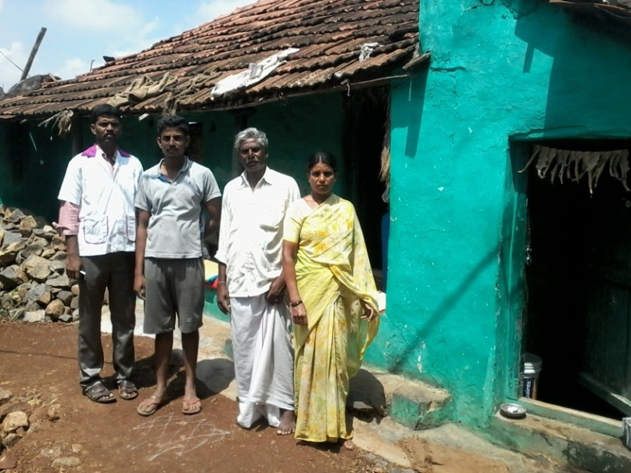
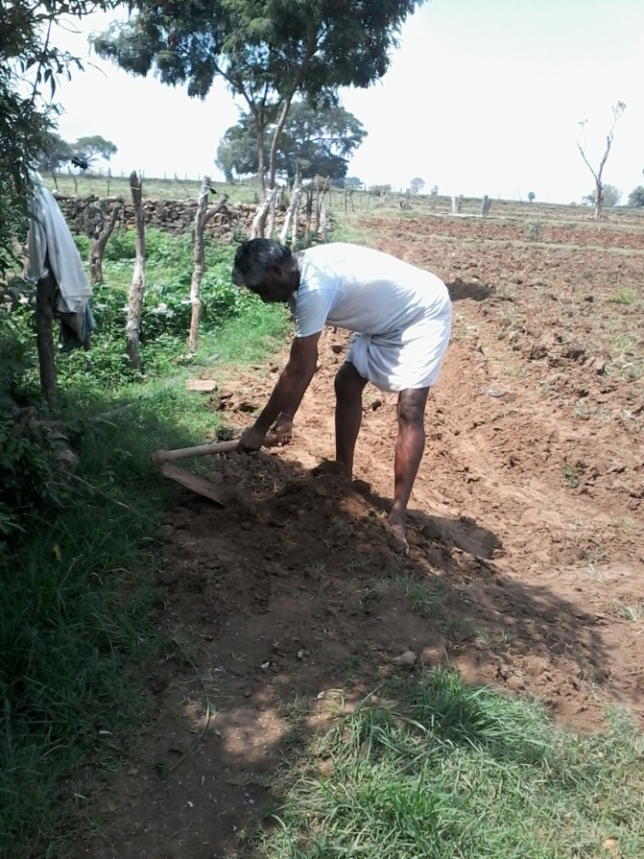
Case Study – Tribal Man
Beneficiary | Mr.Shivamurthy - Scheduled Tribe
Age | 50 years
Village | A.G. Palya, Kollegala Tq, – 135 KM from Chamarajanagar District
Occupation | Daily wage worker in Hill Farming
Problem & Identification | Due to dis-comfort feeling, attended the Special Health Camp arranged for the benefit of Tribal’s on 20th July 2014. The ECG done at the camp was indicative of some heart problem & was referred to Sapthagiri Hospital for further investigations. At the camp he was assured that there wont be financial burden as the entire medical expenses including transportation will be borne under VAS. The investigations revealed of Cardiac problem.
Treatment | Was operated under procedure PTCA on 27th July 2014.
Beneficiary / Family reaction | The beneficiary expressed gratitude to the Government for free facility provided under the scheme. These people are very innocent and simple and were not at all aware of the scheme. The beneficiary and his family were so very happy that free health check up was rendered at their door step, timely diagnosis and treatment and was totally surprised by such personal care and attention given to him at the hospital. He said that he is healthy now not only due to successful operation but also because of mental satisfaction as the care given to poor people was extremely good.

Slide 11
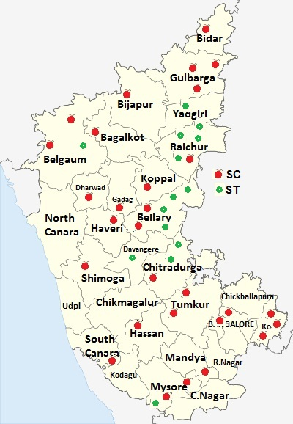
Special Health Camps held at SC/ST Reserved Constituencies
A total of 47 Special Camps were held in Sc & ST Reserved Constituencies in September 2014.
Red dots indicate SC Camps & Green dots ST Camps.
SC / ST Special Camp Details
Division | Total Camps Held | Total Registred | Total Referred | Treated |  | MLT
 |  |  |  | SC | ST
Bangalore | 12 | 5118 | 719 | 227 | 105 | 387
Belgum | 9 | 4704 | 488 | 124 | 55 | 309
Gulbarga | 18 | 4641 | 518 | 172 | 58 | 288
Mysore | 8 | 3427 | 631 | 219 | 109 | 303
Grand Total | 47 | 17890 | 2356 | 742 | 327 | 1287

Slide 12
Phase III: Targeting Most Vulnerable Groups – SC / ST & Hill Tribes
Exclusive Special Health Camps:
Before the launch of the camps, the concerned Hon’ble Ministers and MLAs were contacted and the camps were conducted with their active participation. As the Hon’ble Ministers and MLAs took personal interest, the turnout in each of the camps were beyond expectation.
Full Fledged IEC was also undertaken in advance for maximum impact.
The table below gives the cumulative improvement in the number of SC, ST & Tribal beneficiaries treated till March 2015.
Before Camp
Division | From 2010 to March - 2014
 | SC | ST | General | Total
Bangalore | 197 | 96 | 8378 | 8671
Belgaum | 764 | 379 | 17861 | 19004
Gulbarga | 1647 | 910 | 18143 | 20700
Mysore | 123 | 66 | 8150 | 8339
Total | 2731 | 1451 | 52532 | 56714
%tage | 4.82 | 2.56 | 92.63
After Camp
Division | From 2010 to March - 2015
 | SC | ST | Others | Total
Bangalore | 2613 | 1114 | 15611 | 19338
Belgaum | 2413 | 1043 | 24651 | 28107
Gulbarga | 3894 | 2148 | 21751 | 27793
Mysore | 1621 | 697 | 17381 | 19699
Total | 10541 | 5002 | 79394 | 94937
%tage | 11.10 | 5.27 | 83.63

Slide 13
Special camps September 2015
Division | Total Camps Held | Total Registered | Total Referred | SC | ST | Minority | Others | Asha Referred
Bangalore | 11 | 4113 | 493 | 164 | 81 | 32 | 216 | 29
Belgum | 7 | 2305 | 223 | 56 | 28 | 17 | 122 | 21
Gulbarga | 19 | 3505 | 354 | 88 | 36 | 40 | 190 | 22
Mysore | 6 | 1823 | 263 | 57 | 35 | 5 | 166 | 7
Grand Total | 44 | 12158 | 1364 | 378 | 180 | 94 | 712 | 79

Slide 14
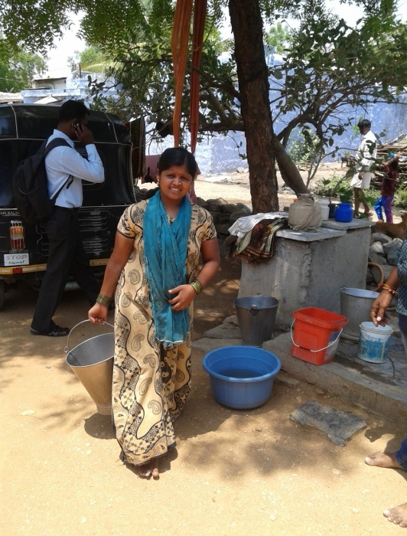

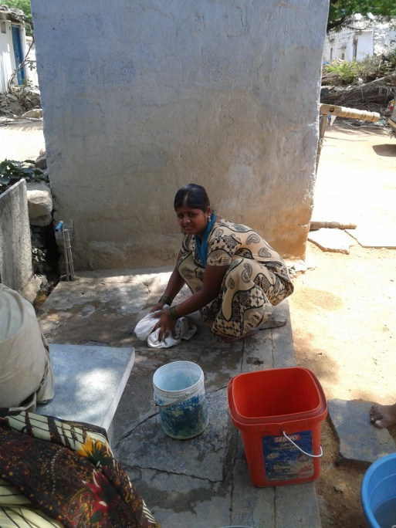
Case Study – Young Woman
Beneficiary | Kavitha w/o Venkatesh, From Scheduled Caste
Age | 20 years – Married just a year back
Village | Arakera K – Shorapur Tq, 80 KM from Yadgir District
Occupation | Husband is a daily wage agricultural labourer (Seasonal)
Problem & Identification | Complained of Breathlessness & Chest Pain – Family could not afford even for check up, were distressed & were about to approach the local quack doctor. Was heartened about VAS Special Health Camp being held at nearby Shorapur Tq on 10th Sept 2014 – Attended the camp & was referred to Mahaveer Jain Hospital for further treatment by arranging free transportation
Treatment | Diagnosed to undergo Cardiothoracic Surgery costing Rs. 1,20,000/- & Surgery done successfully on 27th Sept 2014.
Beneficiary / Family reaction | Husband expressed gratitude to VAS for transforming their life from disaster to that of leading a buoyant & productive life. A classic case of rejuvenation of a young life & family.

Slide 15
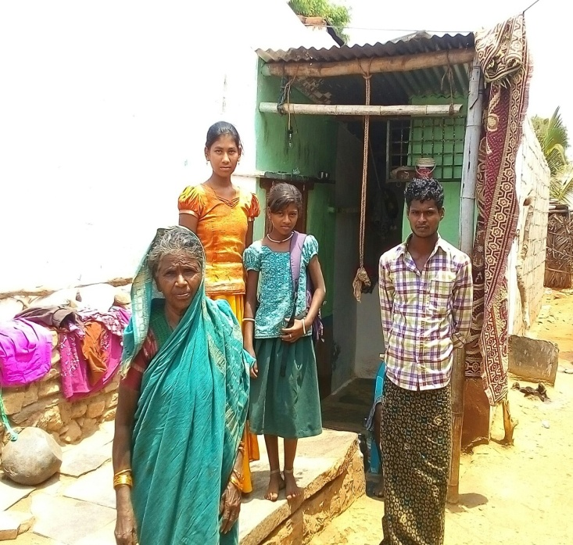
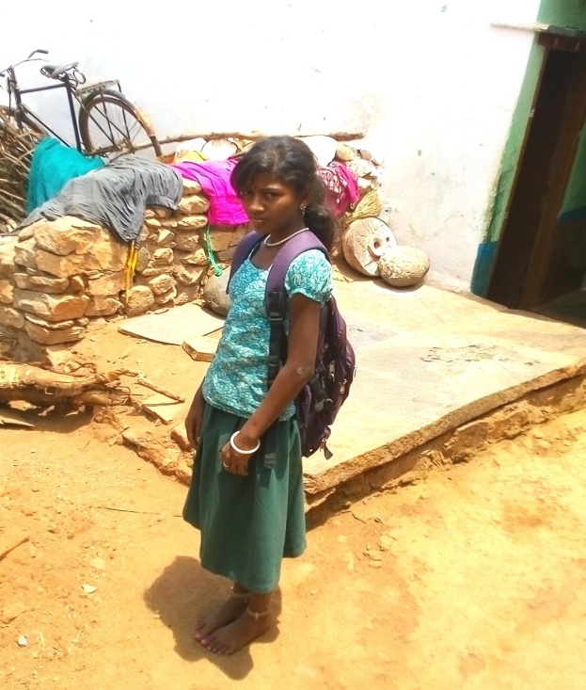
Case Study – School going Girl Child
Beneficiary | Miss. Mangala D/o Mariappa, -Scheduled Tribe
Age | 10 years – School Going
Village | Yenagi, H B Halli Tq, – 75 KM from Bellary District
Occupation | Student
Family Background | Father is bedridden due to paralytic stroke. Mother works as a daily wage labourer & is the main earner. Has two other minor children. Very poor & live in single room tin house.
Problem & Identification | Complained of Chest Pain & could not walk to go to school – Mother was helpless & was performing pooja everyday hoping for divine intervention to heal her daughter. At this juncture, her neighbour informed the mother of the child about VAS Special Health Camp scheduled on 8th Sept 2014 at H B Halli – The child was taken to the camp & the Cardiac specialist doctor from Medihope Hospital advised for immediate hospitalization to undergo cardiac surgery after the necessary investigations.
Treatment | Cardiac Surgery (PDA device closure) Surgery done successfully on 23rd Sept 2014.
Beneficiary / Family reaction | The child’s uncle expressed that considering the families economic condition, they had given up hope of saving the child’s life. He further informed that even if they wanted to borrow money they did not possess any asset to give as collateral security nor was anyone coming forward to lend them money. Today the child is back at school & I am confident that her future will be different from ours only because of VAS. But for VAS, a budding life would have been lost.

Slide 16
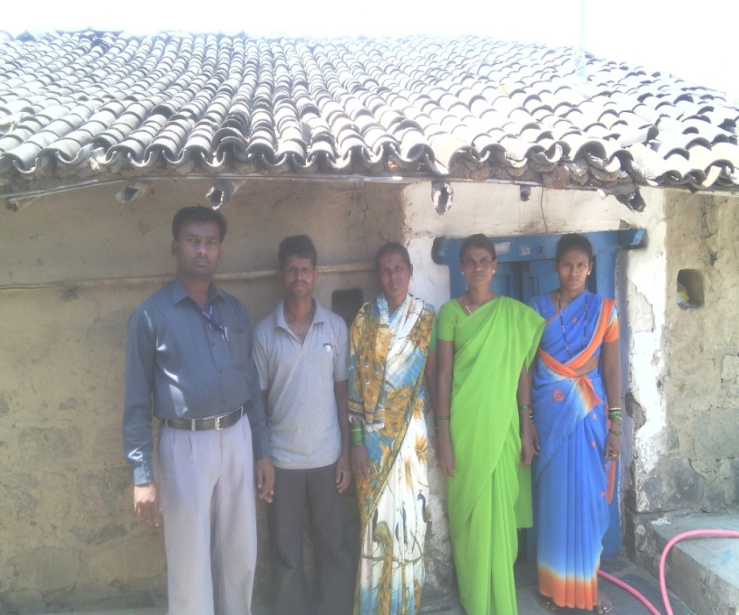
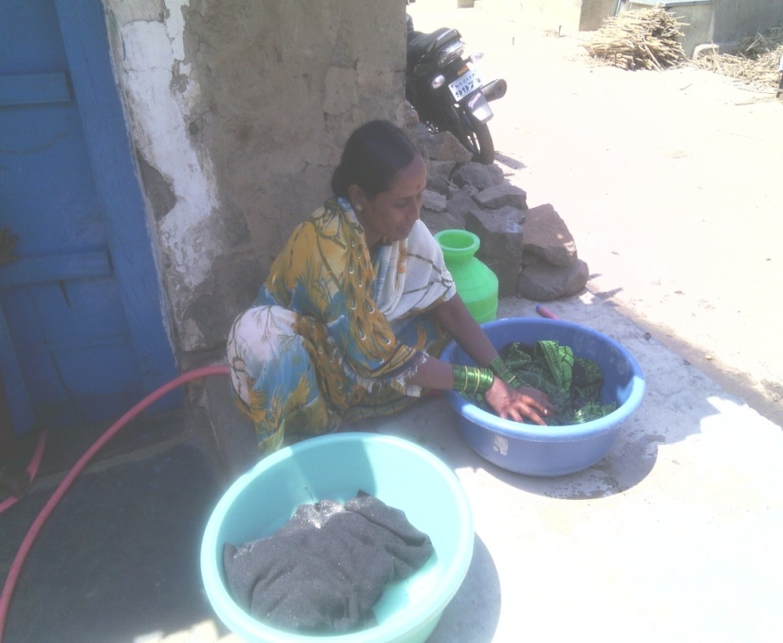
Case Study – Devadasi
Beneficiary | Ms. Sukhdevi Talwar - Scheduled Caste
Age | 40 years
Village | Arjunwada, Hukkeri Tq, – 110 KM from Belgaum District
Occupation | Daily Wage Earner
Family Background | Devadasi.
Problem & Identification | Suspected to have Cervical Cancer identified during Special health Camp held on 15th Sept 2014. Was referred to Kolhapur Cancer hospital for detailed investigation and treatment. After all investigation, confirmed to have cervical cancer and treatment commenced from 20th October 2014.
Treatment | After prolonged treatment under Radiation Therapy (2D CRT), she was discharged on 18th November 2015. She is very much better and is able to do her own chores without any difficulty.
Beneficiary / Family reaction | The total treatment cost was Rs. 85,000/- which she could never afford given the nature of her occupation. But for VAS, the only recourse for her was to suffer silently with prolonged pain.

Slide 17
Phase IV: Promoting Gender Equity
Analyzing specialty wise data, it revealed that women are more
prone to Cancer disease compared to men. This is more virulent in
the age group 26 to 60 years, during which age women are also
expected to contribute economically towards family sustenance.
To ensure that Cancer is detected at an early stage for treatment to
be effective, intensive Cancer screening camps is planned in collaboration with NCD programme of KHSDRP

Slide 18
Phase I: Addressing Economic Equity – Health Assurance to APL Families
Due to the nature of tertiary ailment, the treatment for the same is very prohibitively expensive.
There are many families who do not come under BPL category but nevertheless their financial position is fragile. If any member of the family suffers from any tertiary disease, these families also find it difficult to finance such treatment.
Rajiv Arogya Bhagya: GoK being the first State to move towards UHC, in the interest of Social Justice & Equity, the above category of people and APL families have also been brought under the ambit of Health Assurance on co-payment terms.

Slide 19
Summary
Assessing & Promoting Equity to Health Care
Karnataka has made significant progress in providing tertiary care ensuring both –
Horizontal equity – Covering both BPL & APL population within the State under seven specialties identified for tertiary care in the same empanelled hospitals without discrimination.
Vertical Equity – Specially addressing marginalized groups like Tribals, SC / STs and also giving equal importance to gender equity.

Slide 20
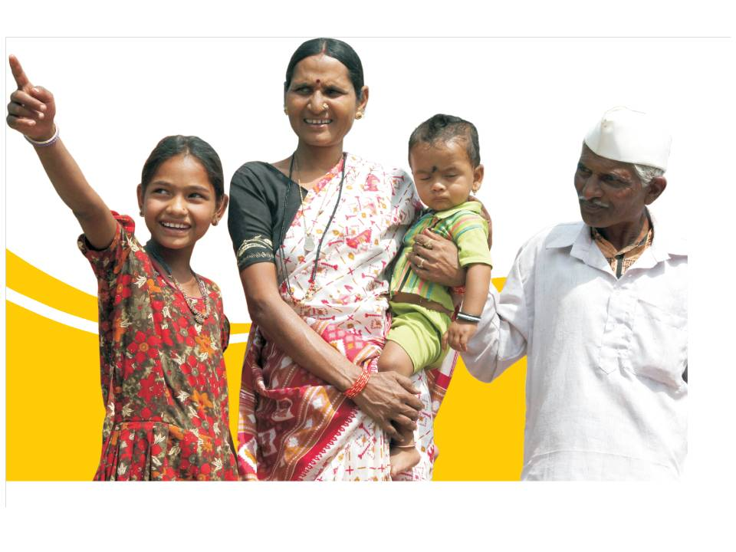

Thank You

